Slide 1

Free Python and Django workshops
for women at EuroPython 2014

Slide 2
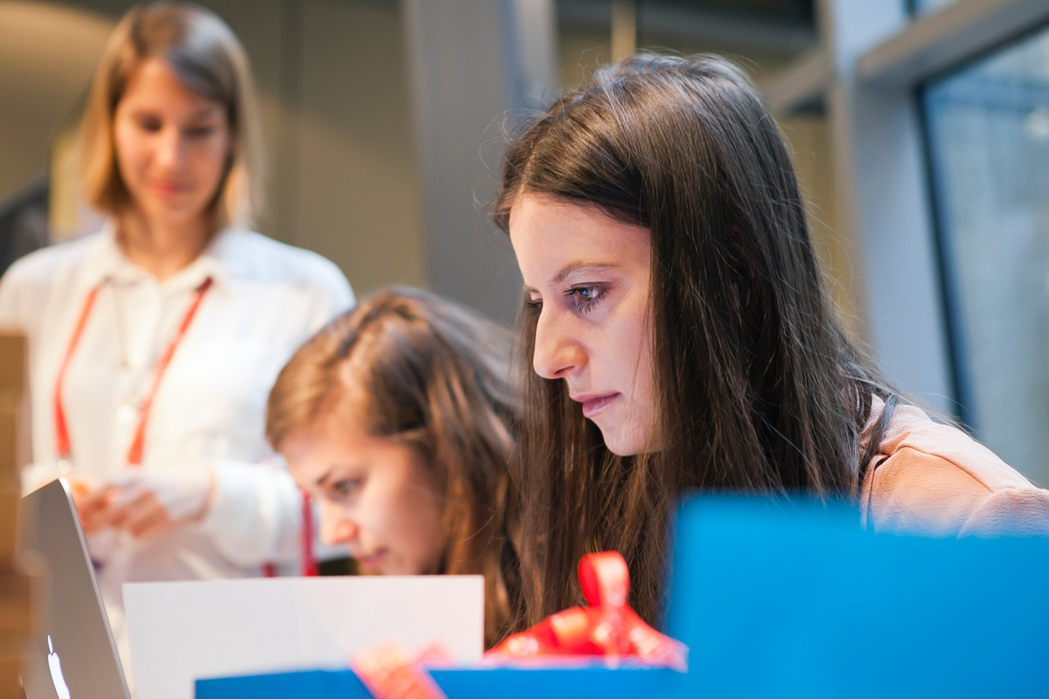
About
21st July 2014
EuroPython, Berlin
Django Girls is an initiative that is aiming
to introduce 40 women who never code before to the world of technology and increase the diversity. During EuroPython 2014 in Berlin, Germany we’re going to organize an one-day workshop and invite girls from all over Europe to join us and learn how to build the internet using HTML, CSS, Python and Django.

Slide 3
Target
Date & place
Supporters
40 underprivileged women who never programmed before but are motivated to get into field
Full day, 21st July 2014
EuroPython 2014, Berlin
(we’re a side EP event, but not organized by EP)
We already have 14 awesome coaches, Django Software Foundation, EuroPython and PyLadies on board!

Slide 4
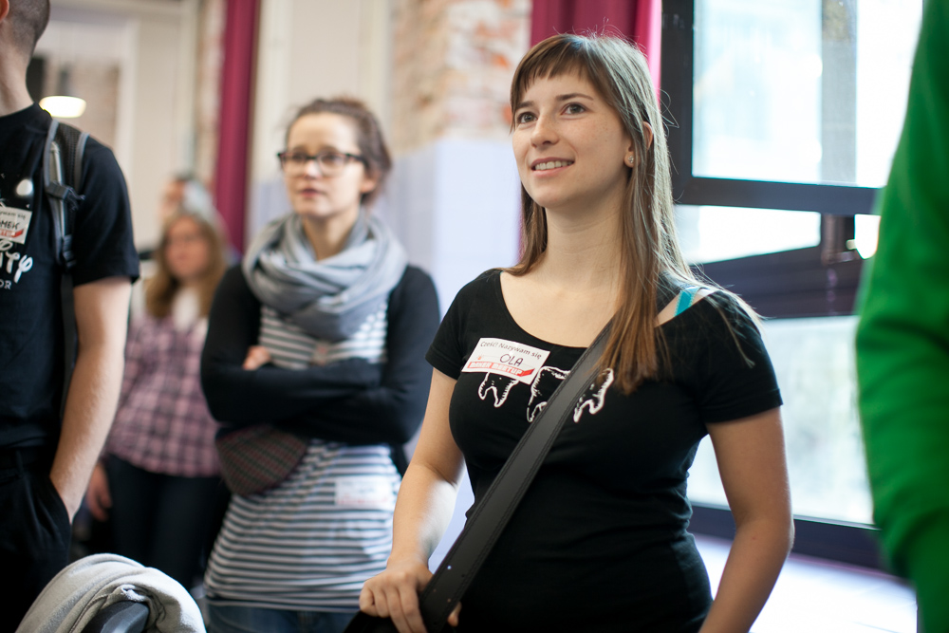
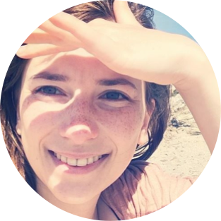
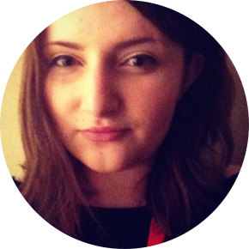
Team
Django Girls is organized by Ola Sendecka and Ola Sitarska. They’re both Django developers and organizers of DjangoCon Europe 2013 (the circus one!) , as well as local Django Sprints or hackathons. They have a big passion for programming and they love getting others to fall in love with it, too.
@asendecka
@olasitarska

Slide 5
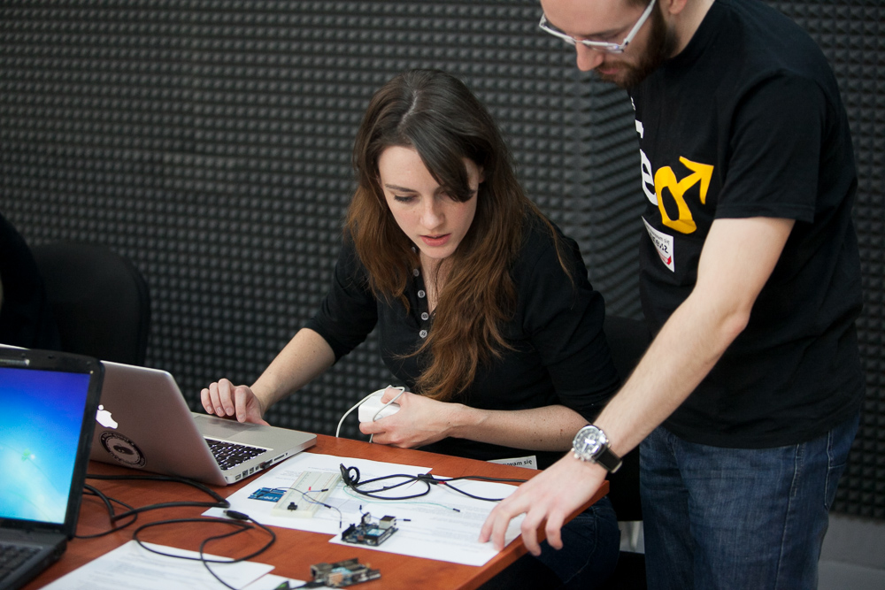
SUPPORT US!
We’re looking for kind souls and organizations that are supporting the goal of bringing more women into technology to help us.
With every sponsor, we can bring more and more women from developing countries to come to Django Girls and EuroPython to learn about programming. Your money will go towards their travel financial aids, resources like books to help
them grow and learn or some little things to make their first contact with code a great experience.
Every woman at Django Girls will also receive a free ticket to the entire conference, courtesy of EuroPython.

Slide 6
SUPPORT US!
You can help us in three ways:
1000 €
800 €
500 €
company logo on website
company poster at workshop
send e-mail to attendees
5-minutes Lightning Talk
company logo on website
company poster at workshop
send e-mail to attendees
company logo on website

Slide 7
Thanks! ♥
djangogirls.org
@djangogirls
fb.me/djangogirls
Get in touch:
hello@djangogirls.org

